Slide 1
KS4 Mastery
Module 1
Holidays

Slide 2
Contents
Vocabulary sheets
Homework vocabulary
Translation task
Writing task (Example Questions: Foundation and Higher/ WAGOLL answers (What A Good One Looks Like)/ Answer Boosters)
90 word 'cheat sheet'
Answers for each task for you to mark.
This will help you to improve your Spanish skills and master the work we cover in class.

Slide 3
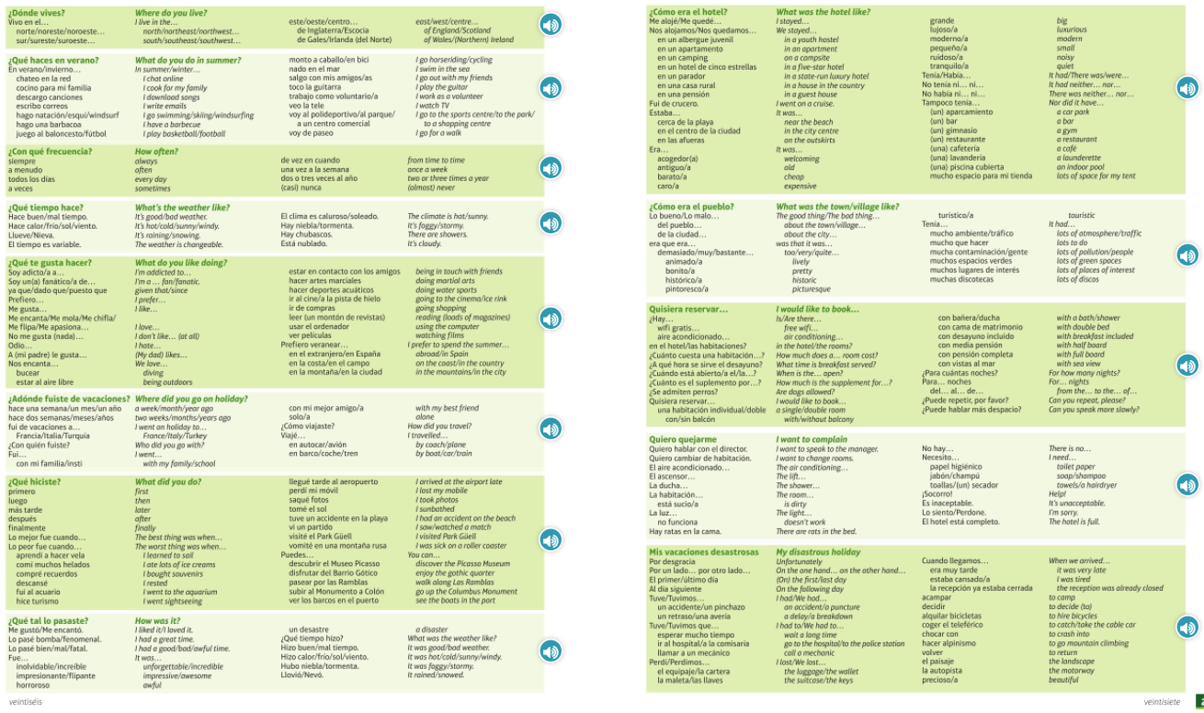
Module vocab

Slide 4
Vocab – Quizlet links
Week 1 https://quizlet.com/_9y6p2l?x=1jqt&i=3gxpjt
Week 2 https://quizlet.com/_9y6pfm?x=1jqt&i=3gxpjt
Week 3 https://quizlet.com/_9y6q5c?x=1jqt&i=3gxpjt
Week 4 https://quizlet.com/_9y6ra6?x=1jqt&i=3gxpjt
Week 5 https://quizlet.com/_9y6sn1?x=1jqt&i=3gxpjt
Week 6 https://quizlet.com/_9y6v0a?x=1jqt&i=3gxpjt
Week 7 https://quizlet.com/_9y6z94?x=1jqt&i=3gxpjt
Week 8 https://quizlet.com/_9y702u?x=1jqt&i=3gxpjt
Week 9 (Higher) https://quizlet.com/_9y70l5?x=1jqt&i=3gxpjt

Slide 5
Topic translations into English
Use the vocab sheet and your existing knowledge of Spanish to translate the following sentences into English.
1. Primero, fui al acuario y luego compré recuerdos en la tienda.
2. Nos alojamos en un albergue juvenil ruidoso cerca de las montañas.
3. ¿Cuánto cuesta una habitación con cama de matrimonio y desayuno incluido?
4. En invierno, no voy de paseo ya que normalmente hace frío y está nublado.
5. Quiero cambiar de habitación, porque está bastante sucia y la luz no funciona.
6. Por desgracia, el último día perdí el equipaje y tuve que llamar a la policía.

Slide 6
Respuestas – mark your answers
1. First, I went to the aquarium and then I bought souveniers in the shop.
2. We stayed in a noisy youth hostel near to the mountains.
3. How much is a room with a double bed and breakfast included?
4. In winter, I don't go for a walk because normally it is cold and cloudy.
5. I want to change my room because it is quite dirty and the light doesn't work.
6. Unfortunately, on the last day I lost my luggage and I had to phone the police.

Slide 7
Topic translations into Spanish
Use the sentence builder and your existing knowledge of Spanish to translate the following sentences into Spanish.
1. I live in the north of England and the weather is extremely changeable.
2. I'm a fan of doing martial arts, but I hate diving.
3. The best thing was when I sunbathed but later I was sick on a roller coaster.
4. I went on a cruise, so there was neither a park nor a supermarket.
5. Where did you go on holiday?
6. On the one hand, it was good weather, on the other hand we had a delay.

Slide 8
Respuestas – mark your answers
1. Vivo en el norte de Inglaterra y el tiempo es extremadamente variable.
2. Soy fanático/a de hacer artes marciales pero odio bucear.
3. Lo mejor fue cuando tomé el sol pero luego vomité en una montaña rusa.
4. Fui de crucero por eso no había ni parque ni supermercardo.
5. ¿Adónde fuiste de vacaciones?
6. Por un lado, hizo buen tiempo, por otro lado tuvimos un retraso.

Slide 9
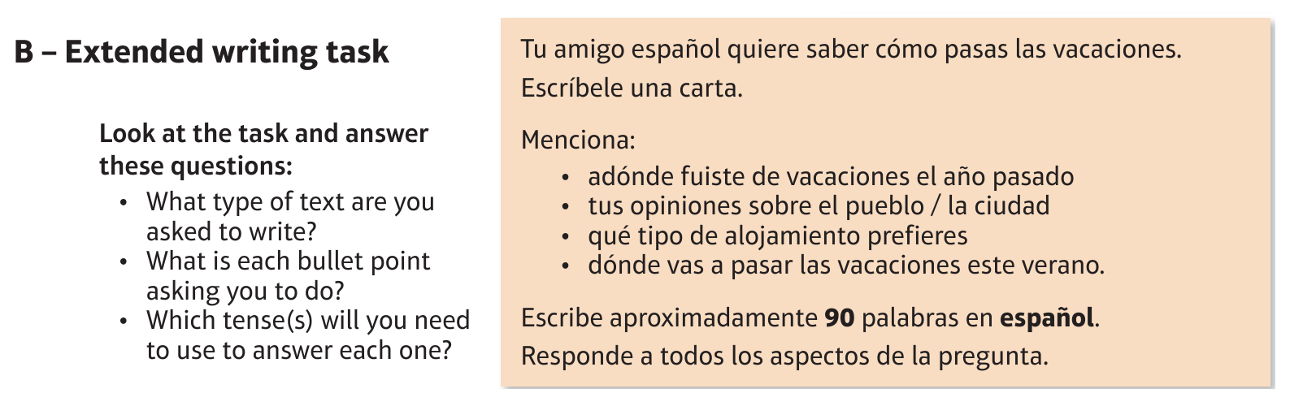
Foundation Holidays: las vacaciones

Slide 10
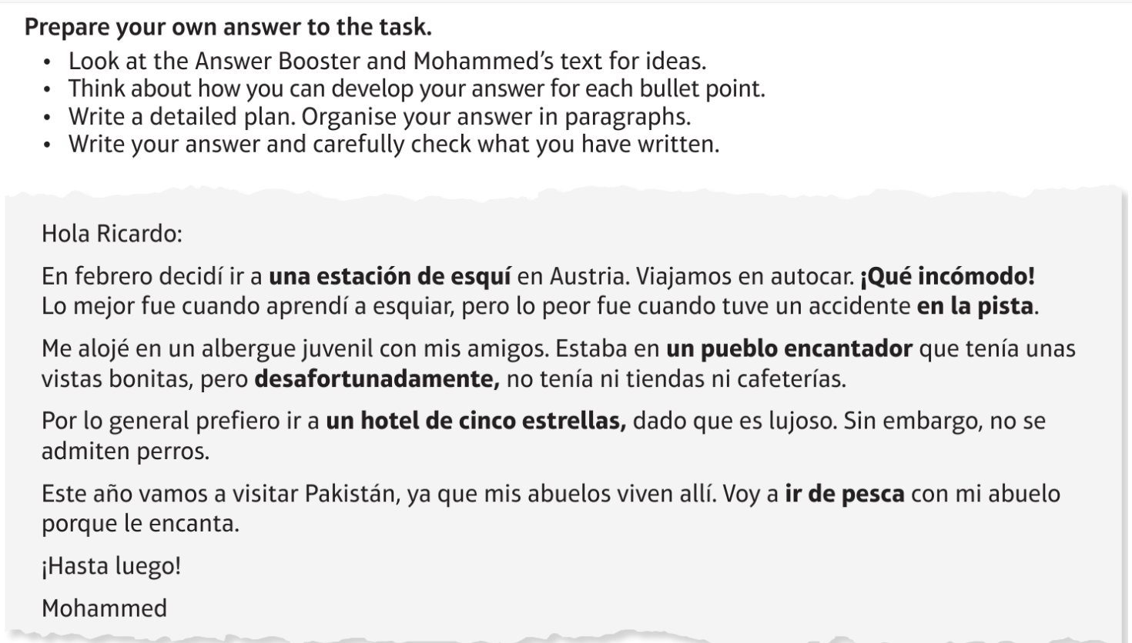
Foundation Holidays: las vacaciones

Slide 11
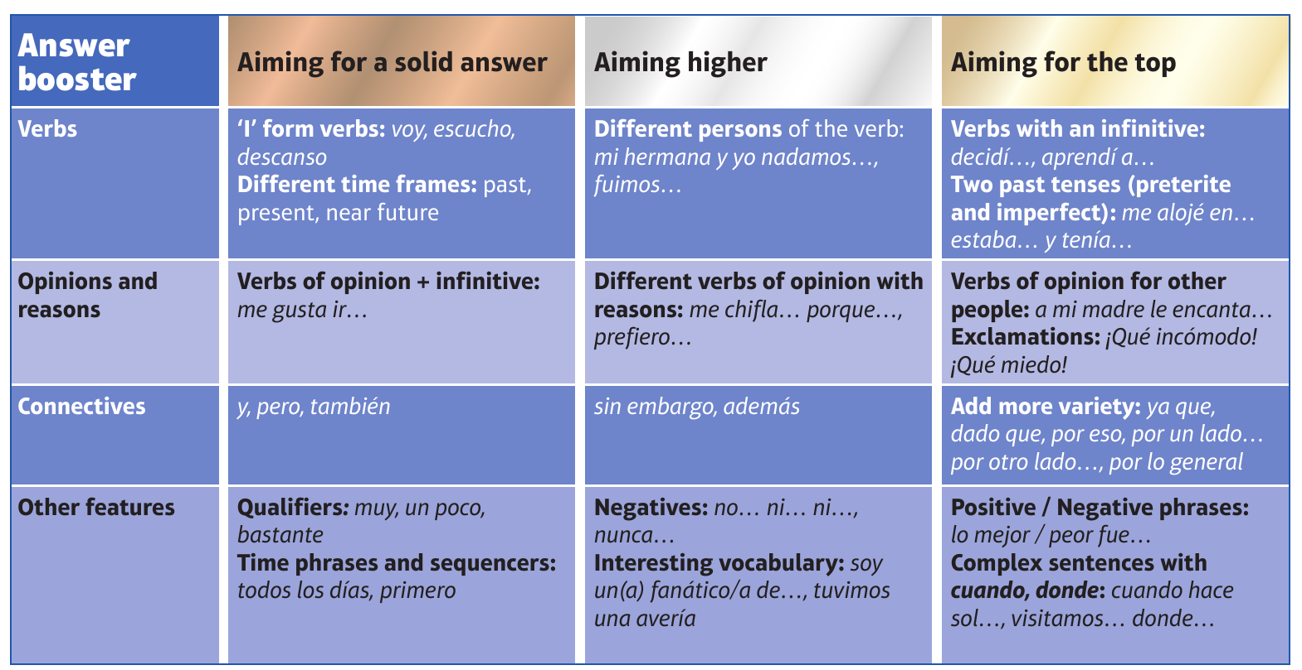
F

Slide 12
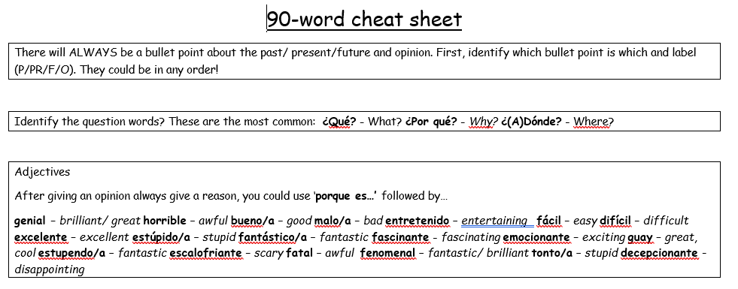
90 word 'cheat' sheet pg. 1

Slide 13
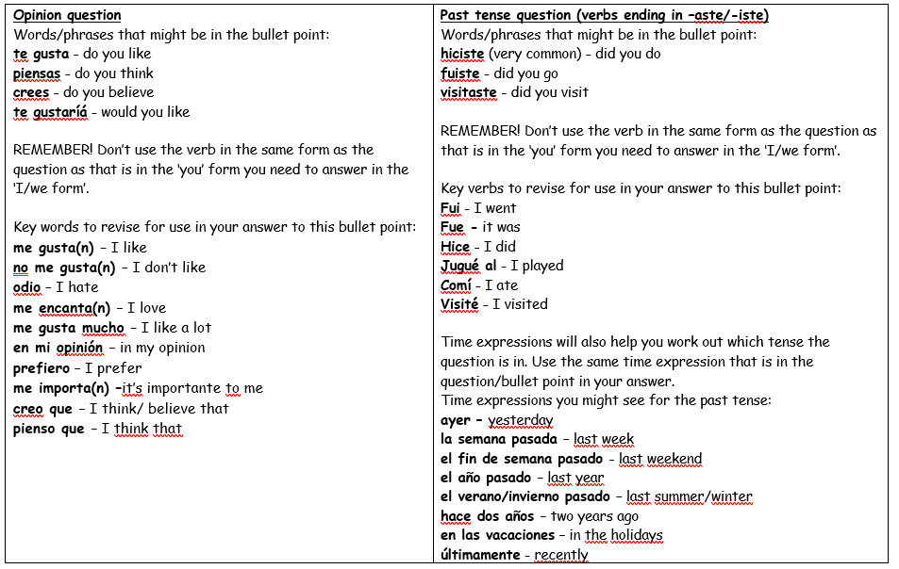
90 word 'cheat' sheet pg. 2

Slide 14
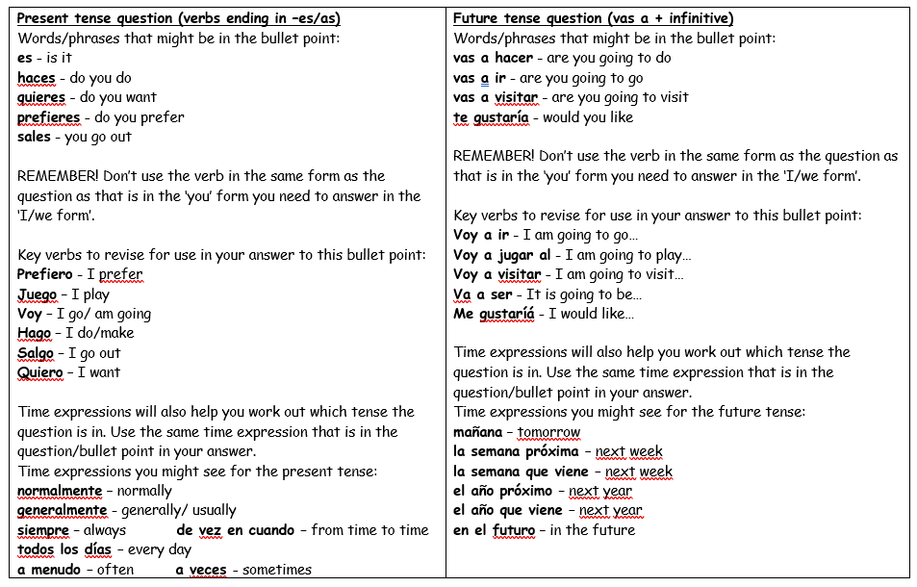
90 word 'cheat' sheet pg. 3

Slide 15
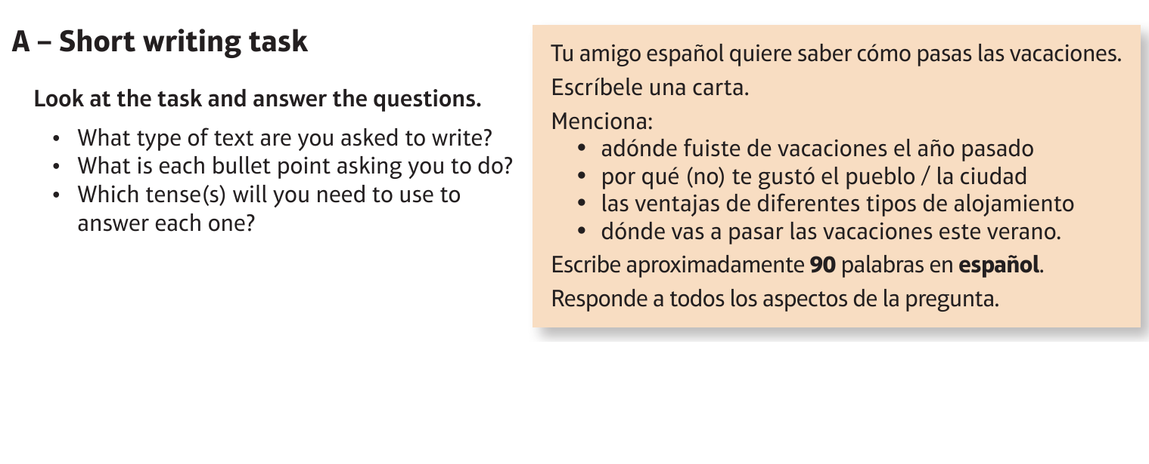
Higher Holidays: las vacaciones

Slide 16
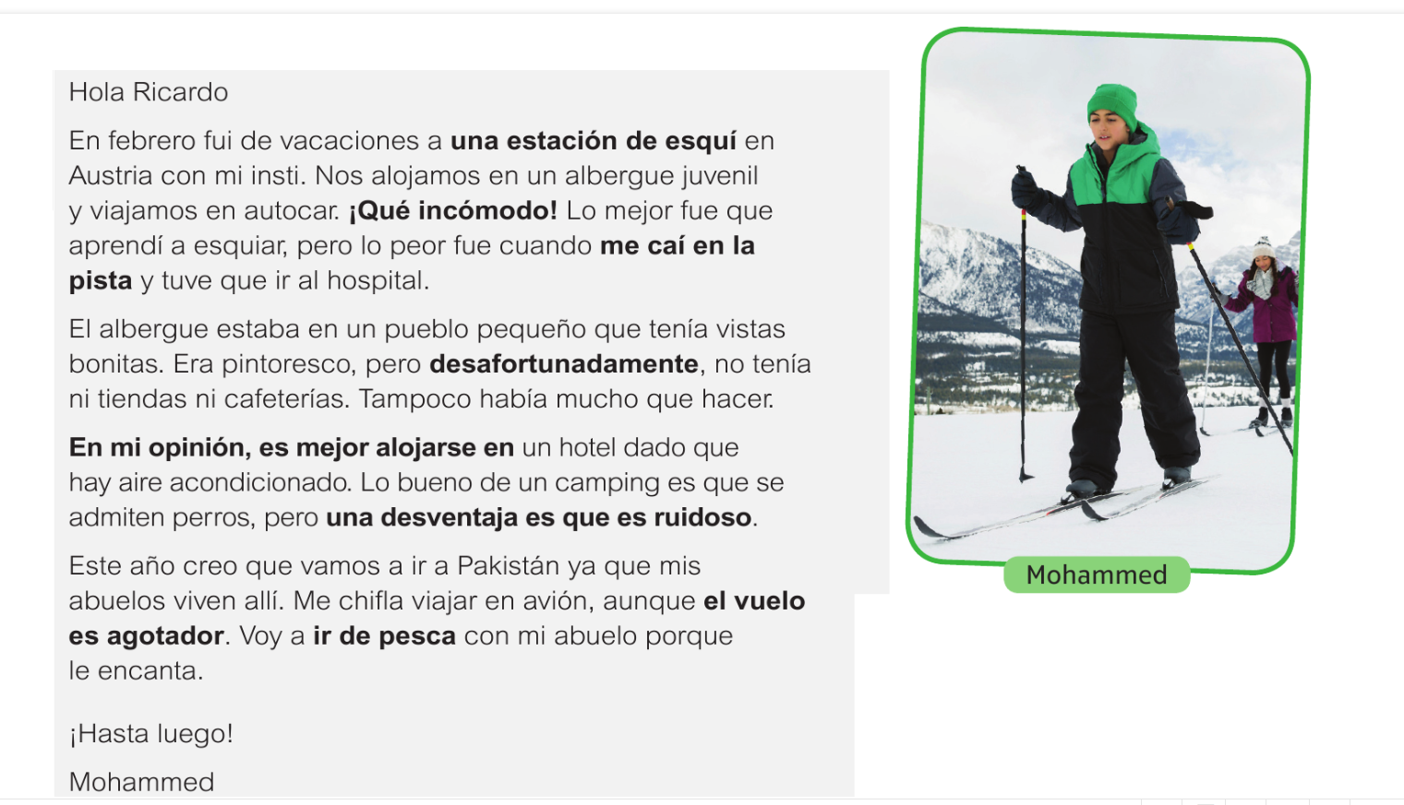
Higher Holidays: las vacaciones

Slide 17
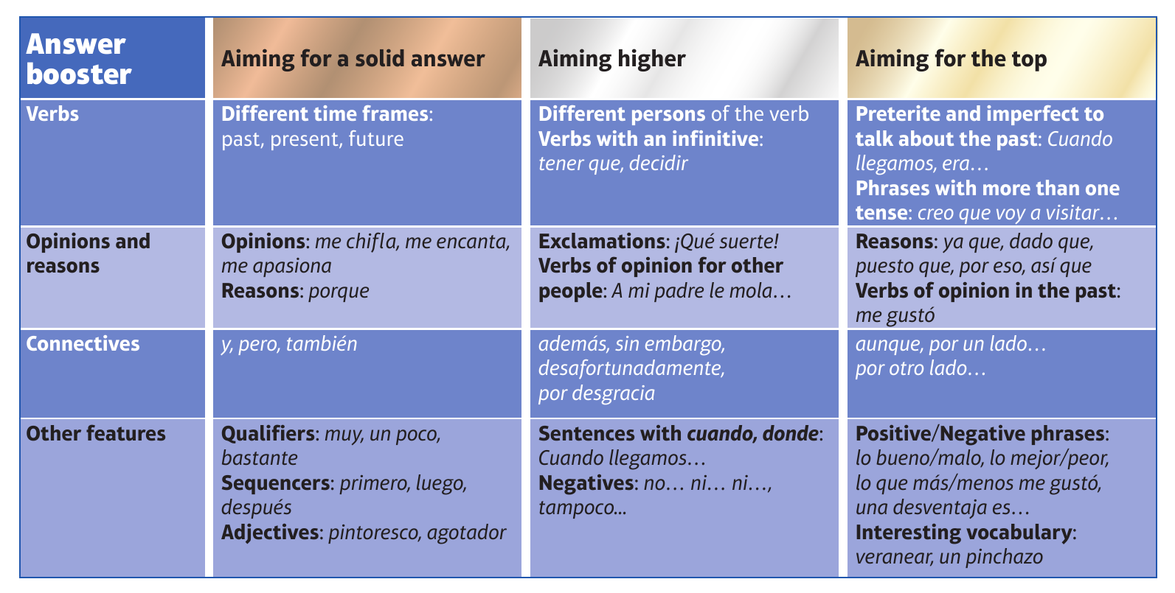
H

