Slide 1
KS4 Mastery
Module 5
Cities

Slide 2
Contents
Vocabulary sheets
Homework vocabulary
Translation task
Writing task (Example Questions: Foundation and Higher/ WAGOLL answers (What A Good One Looks Like)/ Answer Boosters)
90 word 'cheat' sheet
Answers for each task for you to mark.
This will help you to improve your Spanish skills and master the work we cover in class.

Slide 3
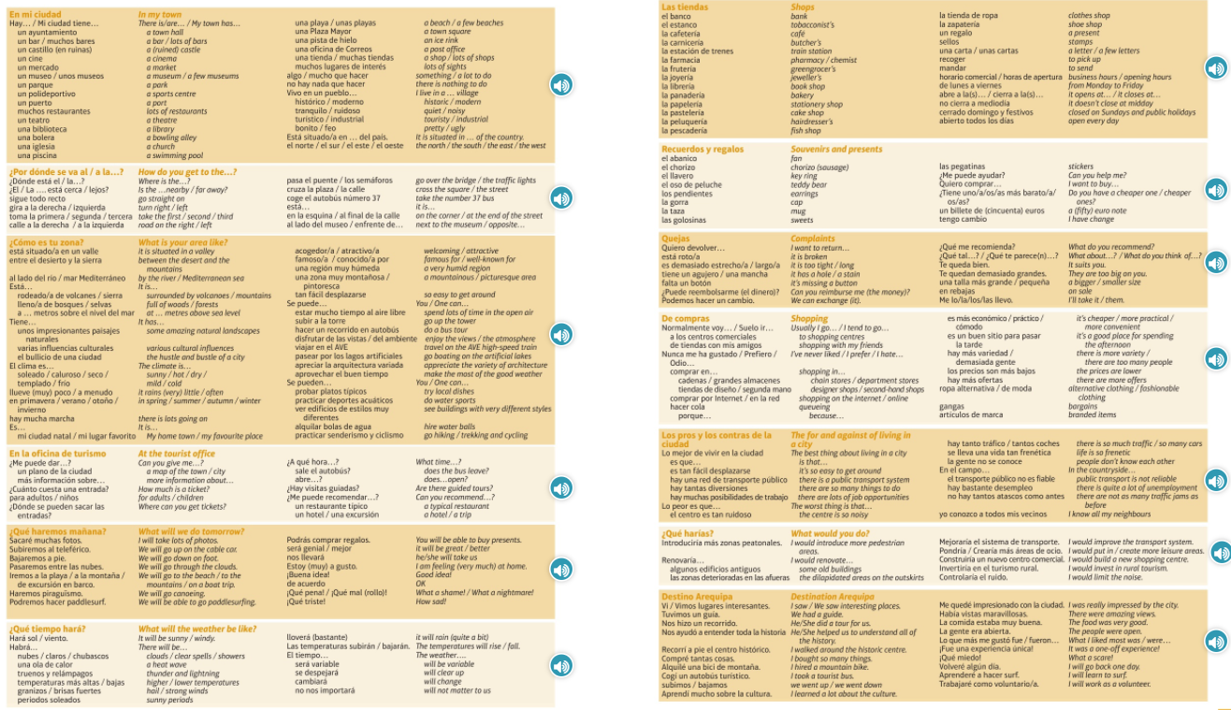
Module vocab

Slide 4
Vocab – Quizlet links
Week 1 https://quizlet.com/_9y2d8r?x=1jqt&i=3gxpjt
Week 2 https://quizlet.com/_9y2efz?x=1jqt&i=3gxpjt
Week 3 https://quizlet.com/_9y2gf0?x=1jqt&i=3gxpjt
Week 4 https://quizlet.com/_9y2h1k?x=1jqt&i=3gxpjt
Week 5 https://quizlet.com/_9y2hm7?x=1jqt&i=3gxpjt
Week 6 https://quizlet.com/_9y2i19?x=1jqt&i=3gxpjt
Week 7 https://quizlet.com/_9y2ilq?x=1jqt&i=3gxpjt
Week 8 https://quizlet.com/_9y2jb0?x=1jqt&i=3gxpjt
Week 9 https://quizlet.com/_9y2jr9?x=1jqt&i=3gxpjt
Week 10 https://quizlet.com/_9y35zr?x=1jqt&i=3gxpjt

Slide 5
Topic translations into English
Use the vocab sheet and your existing knowledge of Spanish to translate the following sentences into English.
1. Mi ciudad está situada al lado del río en el este de mi país, y siempre hay mucha marcha.
2. Suelo ir a los centros comerciales con mis amigos, pero prefiero comprar por internet porque no tengo que hacer cola.
3. lo mejor de vivir en la ciudad es que es tan fácil desplazarse pero la gente no se conoce.
4. Quiero devolver esta camiesta. ¿Puedes reembolsarme el dinero?
5. En Noruega, se puede disfrutar de las vistas porque es una zona realmente pintoresca.
6. Cuando fui a Sevilla, recorrí a pie el centro histórico y aprendí mucho sobre la cultura andaluza.

Slide 6
Respuestas – mark your answers
1. My city is located next to the river in the east of my country, and there is always lots going on.
2. I usually go to shopping centres with my friends but I prefer to shop on the internet because I don't have to queue.
3. The best thing about living in the city is that it is so easy to get around but people don't know each other.
4. I want to return this t shirt. Can you reimburse me the money?
5. In Norway, you can enjoy the views because it is a really picturesque area.
6. When I went to Seville, I walked around the historic centre and I learnt a lot about Andalucian culture.

Slide 7
Topic translations into Spanish
Use the sentence builder and your existing knowledge of Spanish to translate the following sentences into Spanish.
1. I live in an industrial town where there are lots of job opportunities.
2. In Spring, it rains a lot but you can do a bus tour.
3. The bakery in my village doesn't close at midday.
4. I would improve the transport system in Sheffield, because there is so much traffic.
5. Can you recommend a typical restaurant?
6. The bowling alley is at the end of the street on the left.

Slide 8
Respuestas – mark your answers
1. Vivo en una ciudad industrial donde hay muchas posibilidades de trabajo.
2. En primavera, llueve mucho pero se puede hacer un recorrido en autobús.
3. La panadería en mi pueblo no cierra a mediodía.
4. Mejoraría el sistema de transporte en Sheffield porque hay tanto trafíco.
5. ¿Me puede recomendar un restaurante típico?
6. La bolera está al final de la calle a la izquierda.

Slide 9
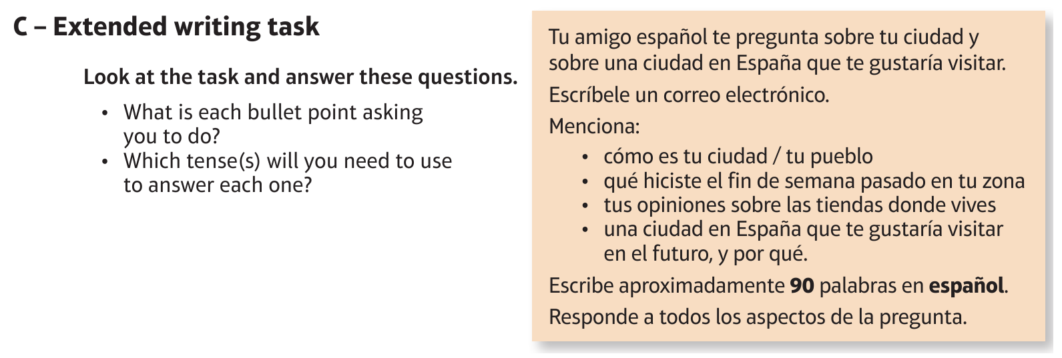
Foundation Town: Mi ciudad

Slide 10
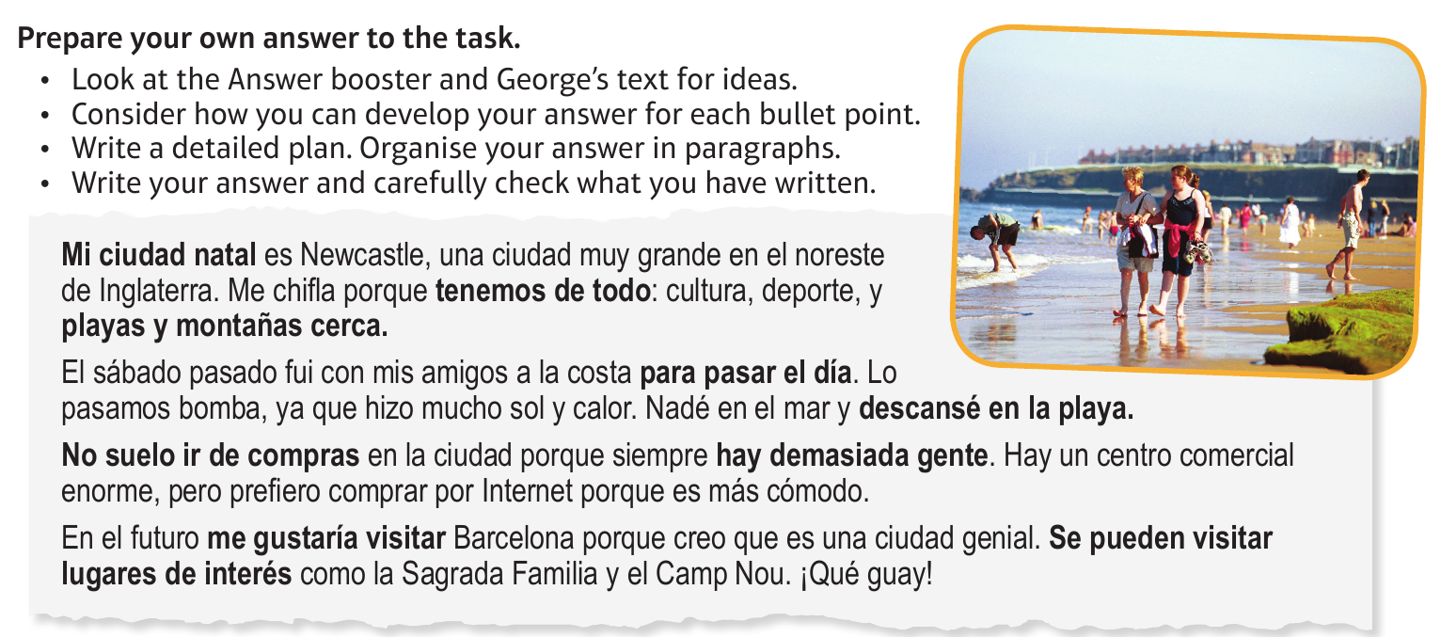
Foundation Town: Mi ciudad

Slide 11
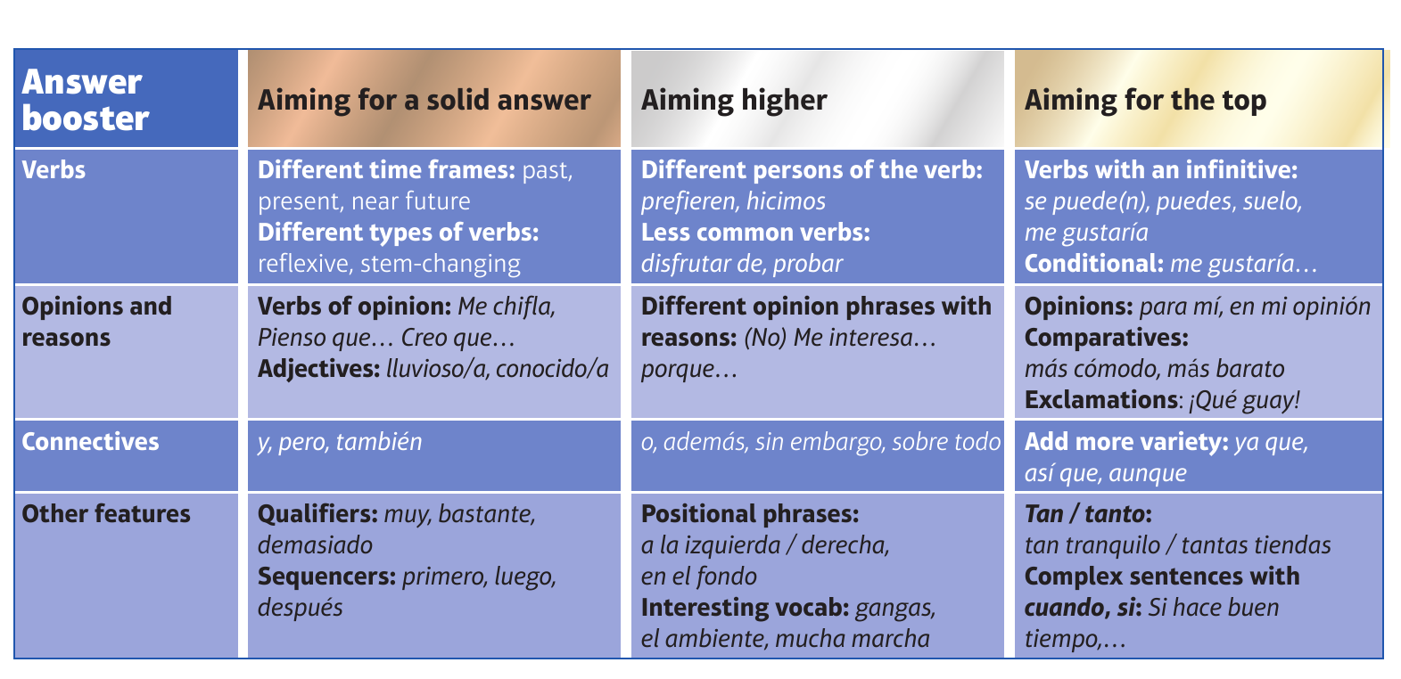
F

Slide 12
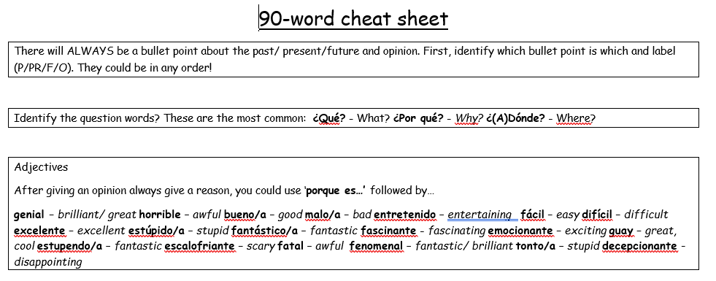
90 word 'cheat' sheet pg. 1

Slide 13
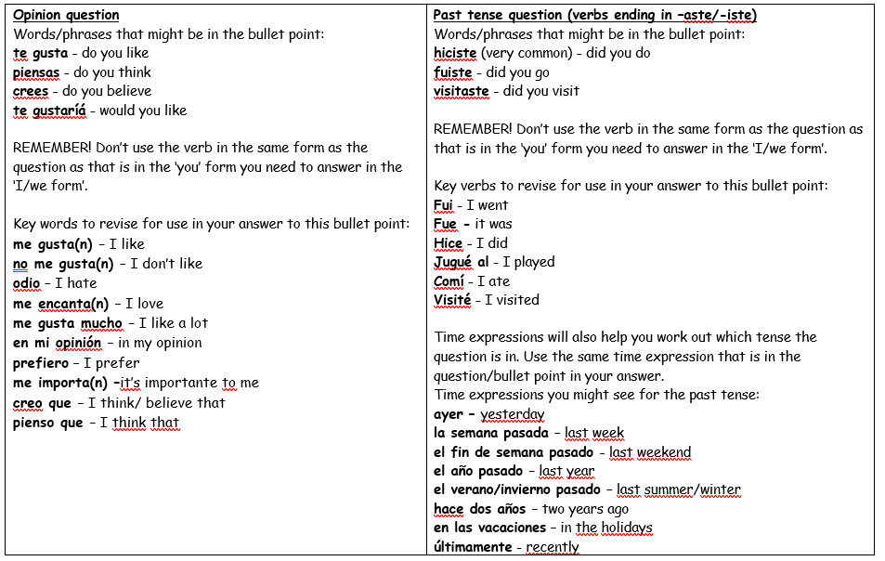
90 word 'cheat' sheet pg. 2

Slide 14
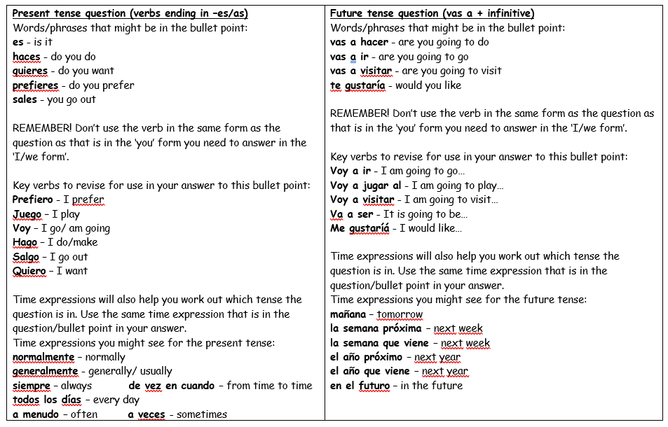
90 word 'cheat' sheet pg. 3

Slide 15
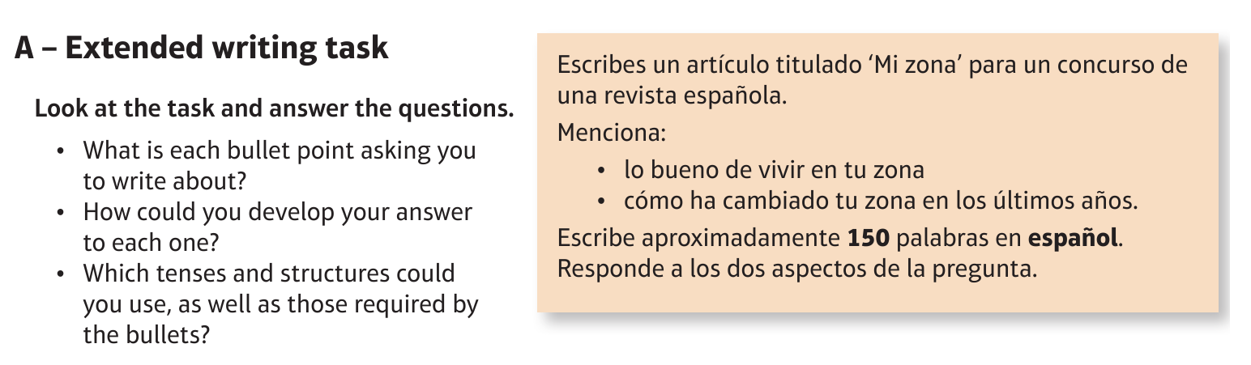
Higher Town: Mi ciudad

Slide 16
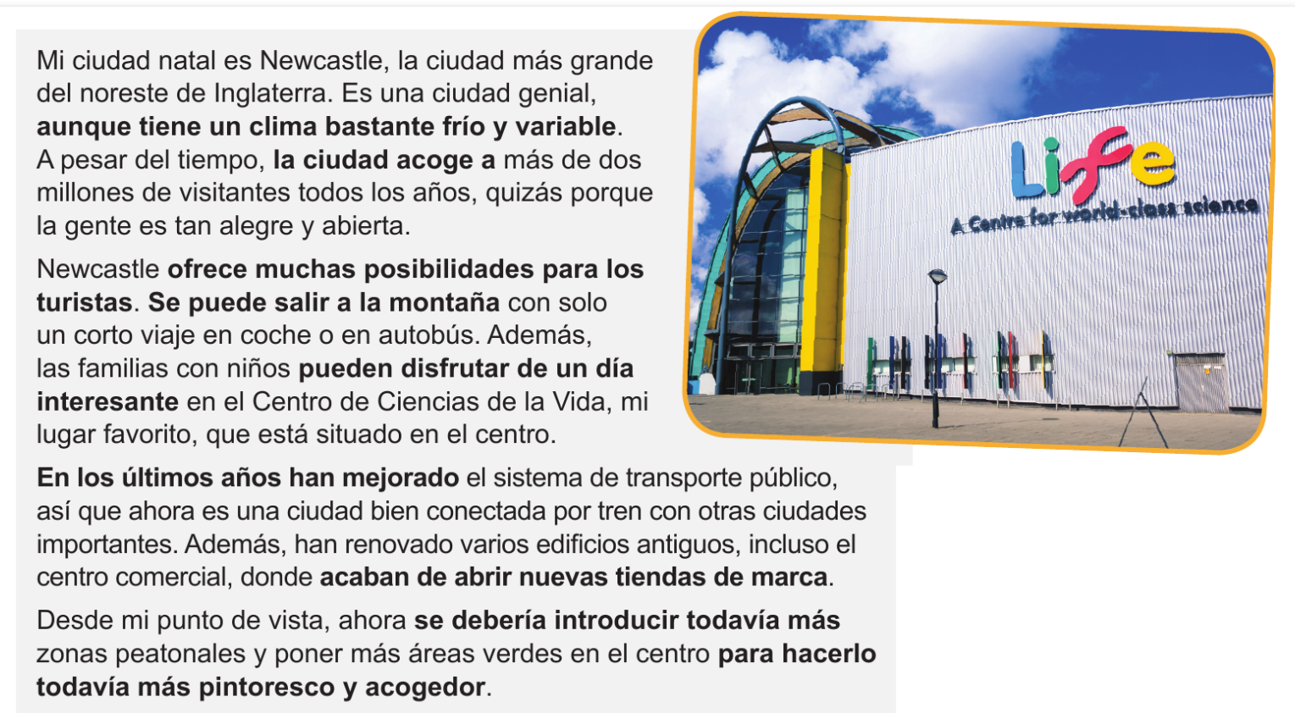
Higher Town: Mi ciudad

Slide 17
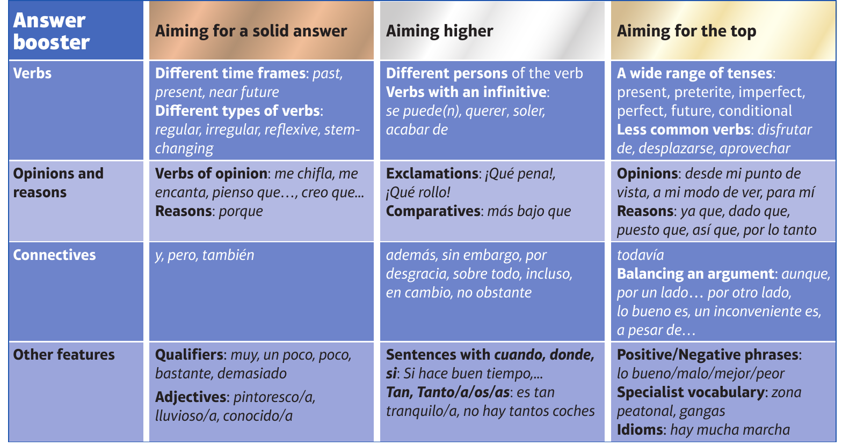
H

