Slide 1
KS4 Mastery
Module 7
Future plans

Slide 2
Contents
Vocabulary sheets​​
Homework vocabulary ​​
Translation task​​
Writing task​​ (Example Questions: Foundation and Higher/ WAGOLL answers (What A Good One Looks Like)/ Answer Boosters)
90 word 'cheat' sheet
Answers for each task for you to mark.​​
This will help you to improve your Spanish skills and master the work we cover in class.

Slide 3
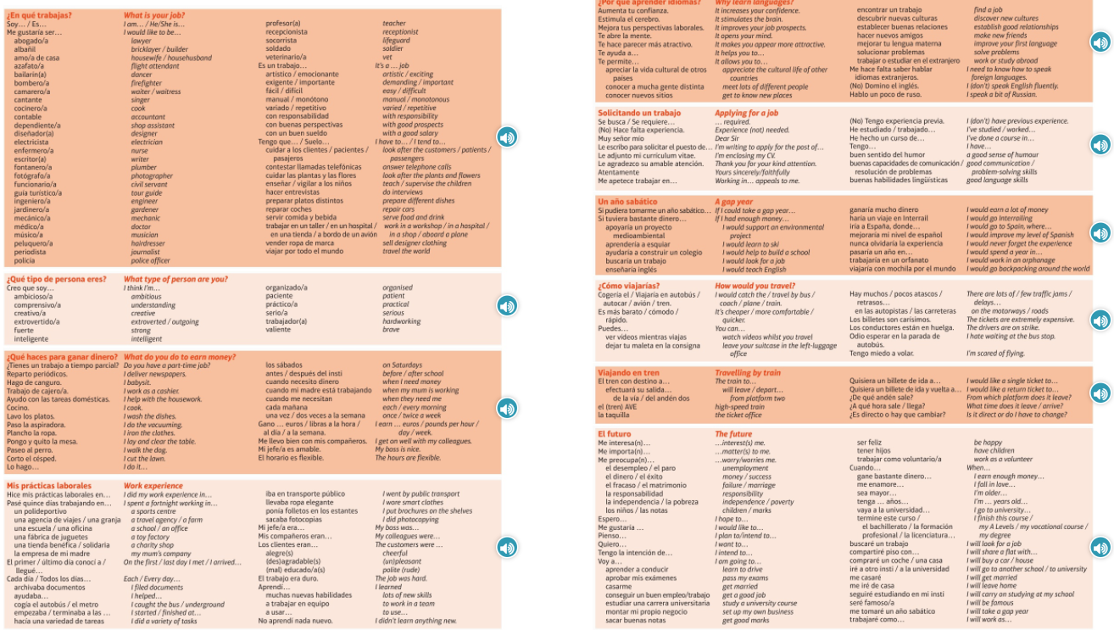
Module vocab

Slide 4
Vocab – Quizlet links
Week 1 https://quizlet.com/_9y735e?x=1jqt&i=3gxpjt
Week 2 https://quizlet.com/_9y73qa?x=1jqt&i=3gxpjt
Week 3 https://quizlet.com/_9y77gq?x=1jqt&i=3gxpjt
Week 4 (Higher) https://quizlet.com/_9y77or?x=1jqt&i=3gxpjt

Slide 5
Topic translations into English
Use the vocab sheet and your existing knowledge of Spanish to translate the following sentences into English.
1. Tengo un trabajo a tiempo parcial en un restaurante donde lavo los platos.
2. Si pudiera tomarme un año sabático, enseñaría inglés a los niños en un país diferente.
3. Quisiera un billete de ida y vuelta a Alicante, por favor. ¿Cuánto cuesta?
4. Me gustaría ser socorrista porque es un trabajo con responsablidad y me gusta nadar.
5. Pasé cinco días trabajando en una fábrica de juguetes, pero mi jefe era un poco maleducado y no aprendí nada nuevo.
6. En el futuro, tengo la intención de ir a la universidad y cuando gane bastante dinero, quiero comprar un coche rojo.

Slide 6
Respuestas – mark your answers
1. I have a part time job in a restaurant where I wash the dishes.
2. If I could take a gap year, I would teach English to children in a different country.
3. I would like a return ticket to Alicante please. How much does it cost?
4. I would like to be a lifeguard because it is a job with responsibility and I like to swim.
5. I spent five days working in a toy factory but my boss was a bit rude and I didn't learn anything new.
6. In the future, I intend to go to university and when I earn enough money, I want to buy a red car.

Slide 7
Topic translations into Spanish
Use the sentence builder and your existing knowledge of Spanish to translate the following sentences into Spanish.
1. I am a journalist, which is a very demanding and varied job.
2. I think I'm quite creative, so I would like to be a hairdresser or a designer.
3. On Saturdays, I babysit and normally I earn 20 pounds.
4. Every day, I caught the bus at half past seven.
5. I think that learning languages allows you to establish good relationships and improves your job prospects.
6. When I go to university, I will share a flat with other young people but I'm worried about the independence.

Slide 8
Respuestas – mark your answers
1. Soy periodista que es un trabajo muy exigente y variado.
2. Pienso que soy bastante creativo/a por eso me gustaría ser peluqero/a o diseñador/a.
3. Los sábados, hago de canguro y suelo ganar/normalmente gano veinte libras.
4. Todos los días, cogía el autobús a las siete y media.
5. Pienso que aprender idiomas/lenguas te permite establecer buenas relaciones y mejora tus perspectivas laborales.
6. Cuando vaya a la universidad, compartiré piso con otros jovenes pero me preocupa la independencia.

Slide 9
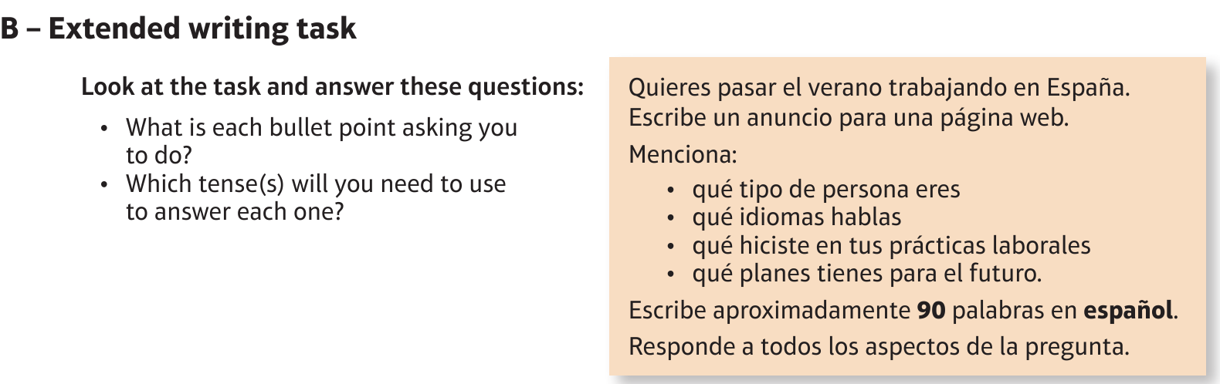
Foundation Work: El trabajo/ empleo

Slide 10
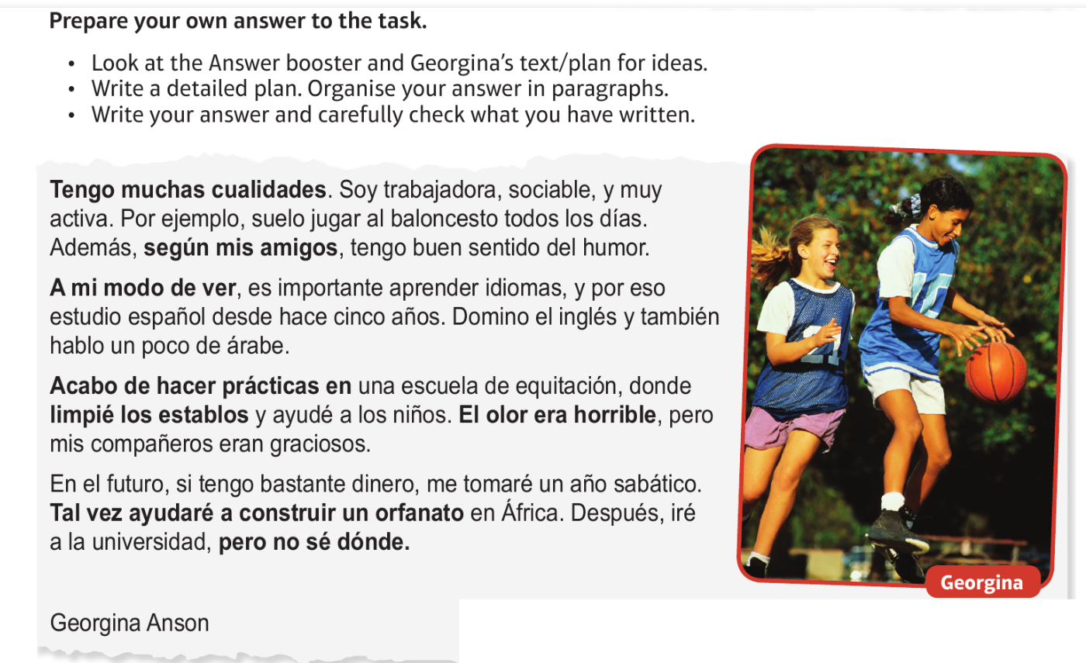
Foundation Work: El trabajo/ empleo

Slide 11
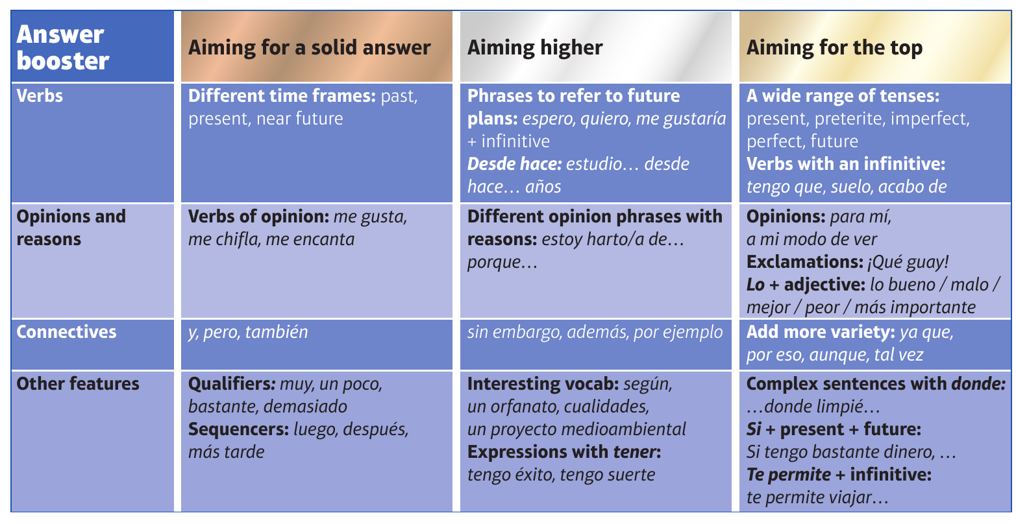
F

Slide 12
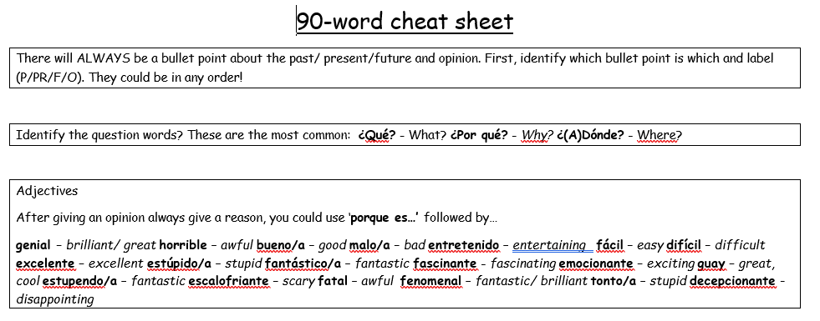
90 word 'cheat' sheet pg. 1

Slide 13
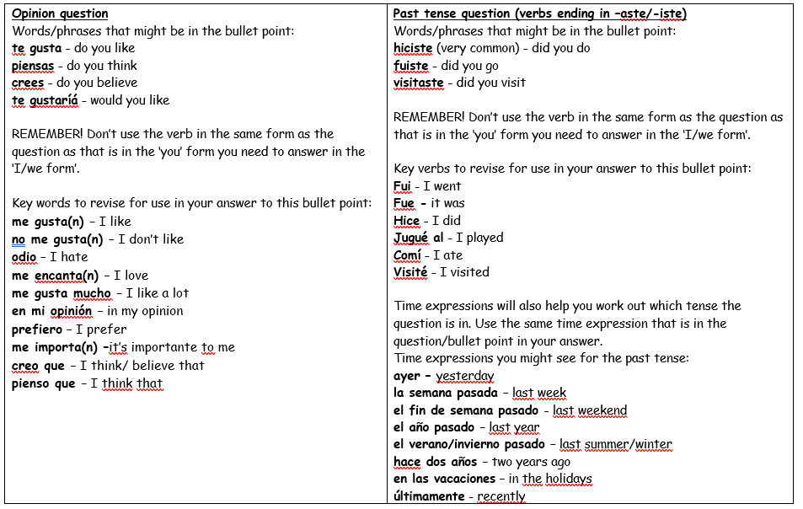
90 word 'cheat' sheet pg. 2

Slide 14
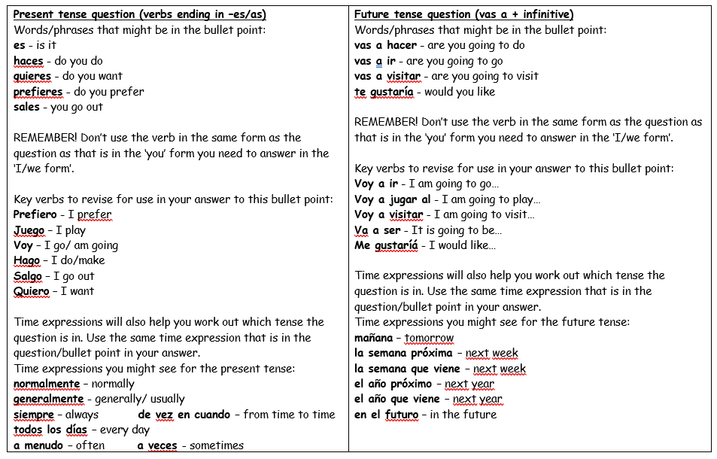
90 word 'cheat' sheet pg. 3

Slide 15
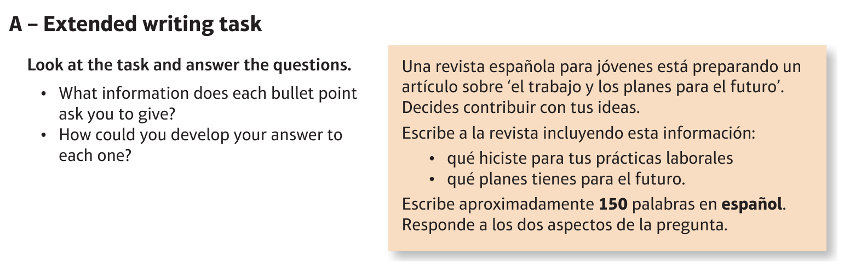
Higher Work: El trabajo/ empleo

Slide 16
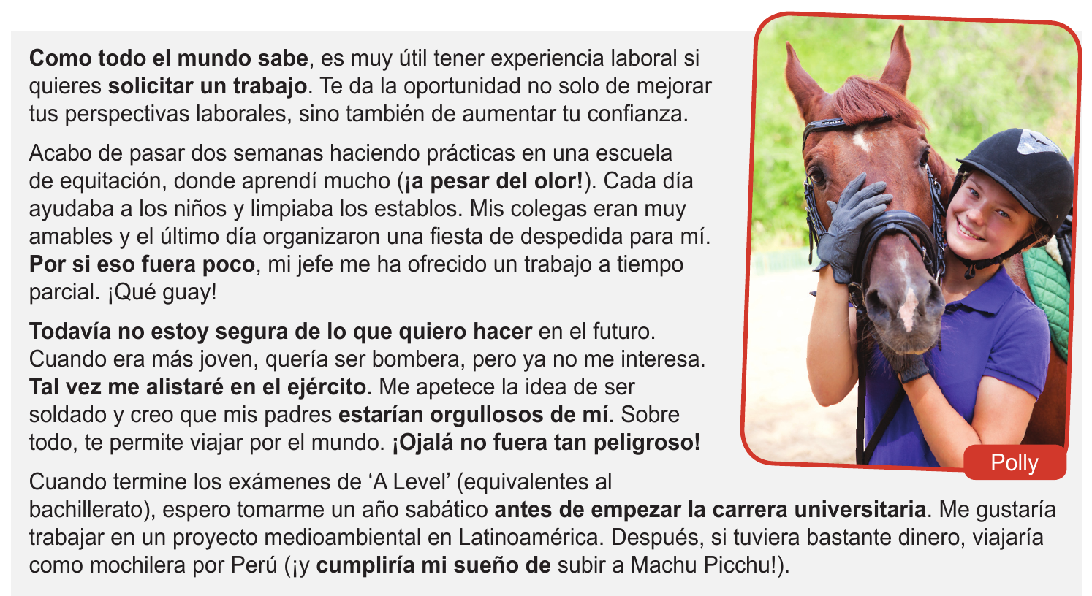
Higher Work: El trabajo/ empleo

Slide 17
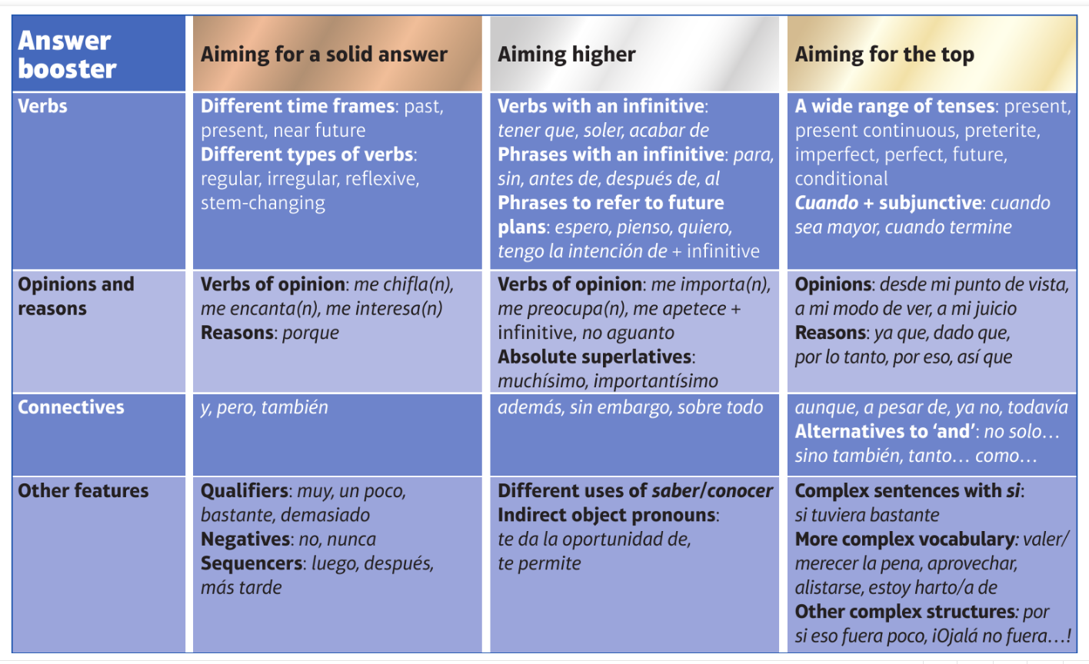
H

