Slide 1




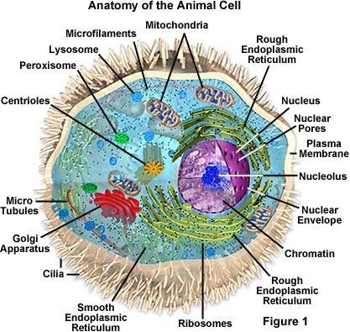

Welcome to A level Biology
Exam board: AQA

Slide 2
Your teachers
Miss Hazelby – 2 lessons per week
shazelby@forgevalley.sheffield.sch.uk
Miss Isle – 2 lessons per week
kisle@forgevalley.sheffield.sch.uk
Mr Walker – 1 lesson per week
twalker@forgevalley.sheffield.sch.uk

Slide 3
How is the course assessed?
Your understanding and learning will be assessed through written exams at the end of Y12 and/or Y13.
There will be three papers at the end of Y13 for the A-level and two papers at the end of Y12 for the AS level which test your knowledge as well as your practical skills.
You will also have your practical abilities assessed by your teacher which will be reported on your final certificate as the Practical Endorsement for Biology.

Slide 4
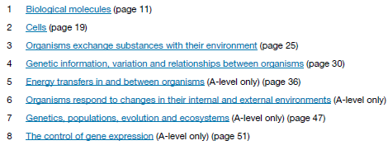
Overview of topics
All links back to and builds upon GCSE biology – summer work is very important to ensure a strong foundation of knowledge.

Slide 5
Summer work
https://app.senecalearning.com/dashboard/join-class/swe3lwk5ug
https://www.forgevalley.school/page/?title=Transition+to+Forge+Valley+Sixth+Form&pid=132
https://www.aqa.org.uk/subjects/science/as-and-a-level/biology-7401-7402

Slide 6
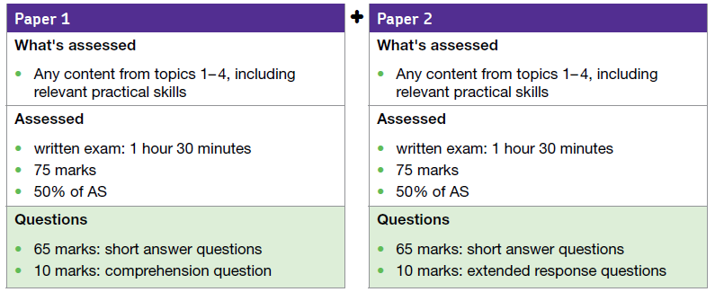

Slide 7
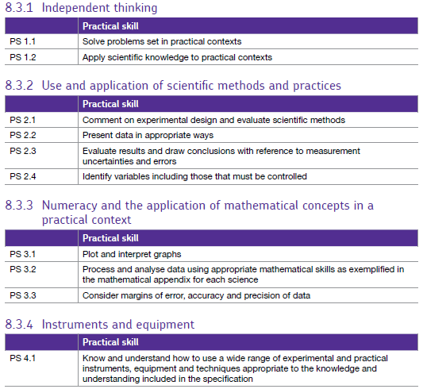

Slide 8
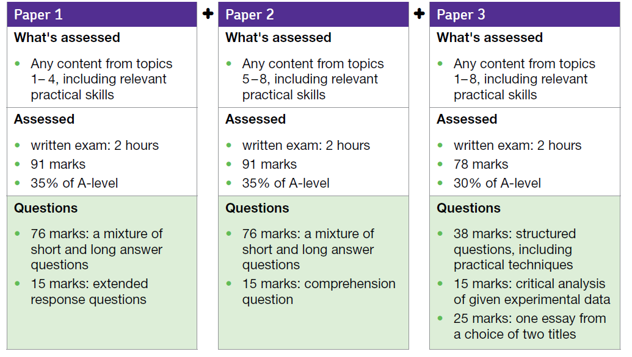

Slide 9
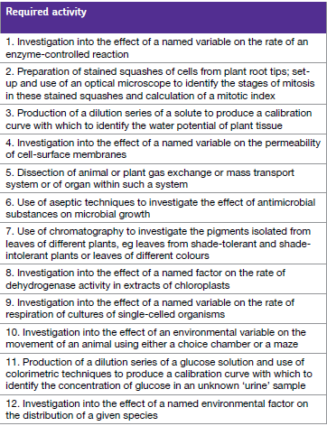

Slide 11
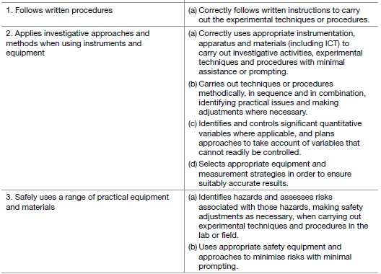

Slide 12
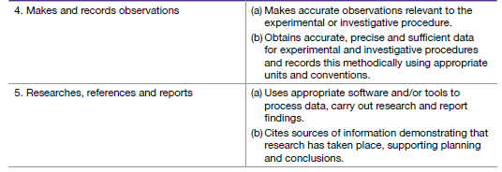

Slide 13
Things to have ready for September!
Get yourself a folder with 10 dividers for each of the chapters that you will study in Y12.
Equipment – pencil case, scientific calculator etc, A4 lined paper, ruler.
We will provide you with a required practical folder.
You can get a physical copy of the Y12 book in September (£10 deposit – repayable when returned) we also have a pdf version online.

Slide 14
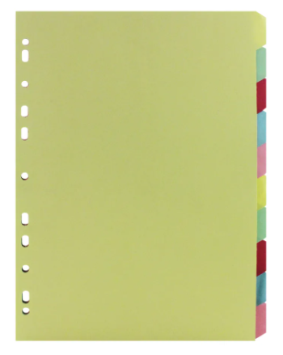

Expectations
You must be organised! There is a lot of work so you need to stay on top of things and organise your notes in your folders.

Slide 15
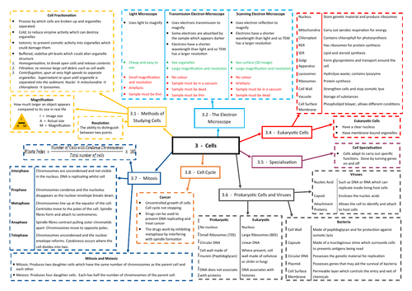
Expectations
Consolidate notes after each lesson (mind map, flash cards).

Slide 16
Expectations
Complete all homework on time, you must email your teacher if you need help before the deadline!
5 hours of lessons per week should be matched with 5 hours of work outside lessons (includes consolidating notes and homework).
Use your frees to do work!
Email your teacher if you are absent and ask for catch up work, this is your responsibility!!
https://www.youtube.com/watch?v=LyDfhCLx8HI

Slide 17

Careers

Slide 18
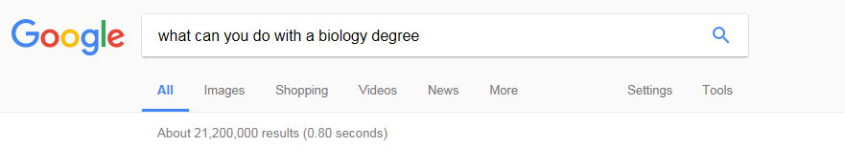
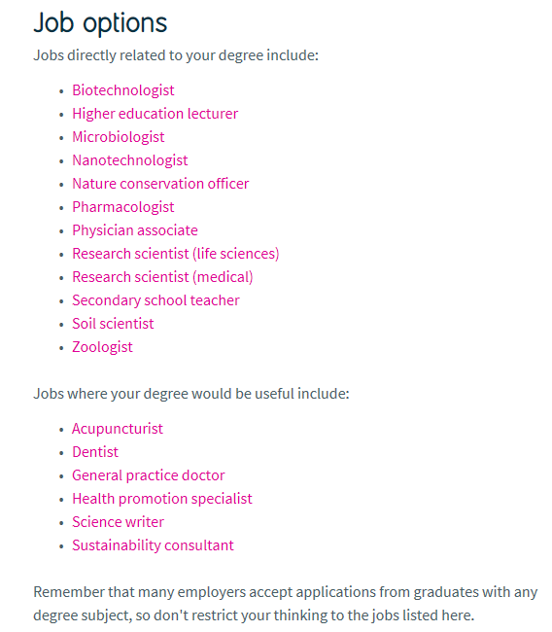

Slide 19
Any questions?

Slide 22
